Slide 1
Angular JS – JS on roids

Slide 2
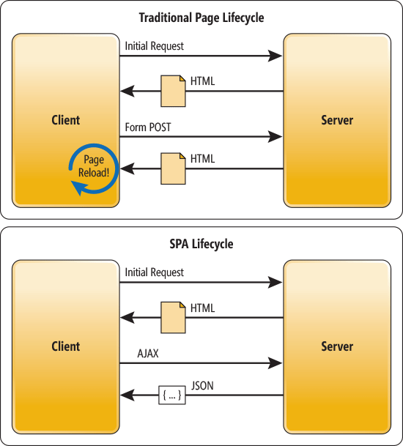
SPA – What’s the fuss about?

Slide 3
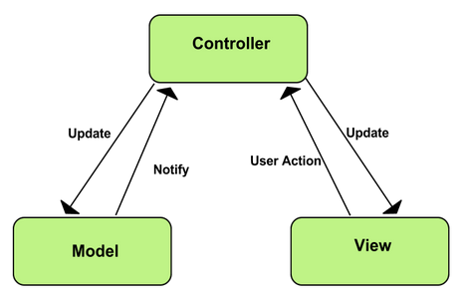
MVC – Let’s bust the jargon

Slide 4
Angular – The big daddy
Backbone JS
React JS
Knockout
Ember
http://codebrief.com/2012/01/the-top-10-javascript-mvc-frameworks-reviewed/

Slide 5
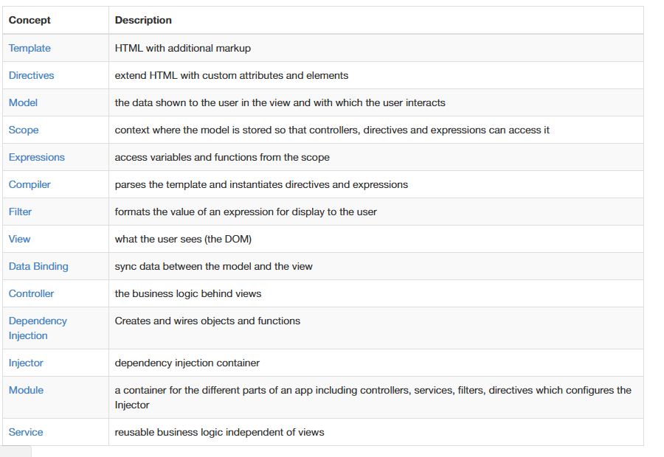
Important terms

Slide 6
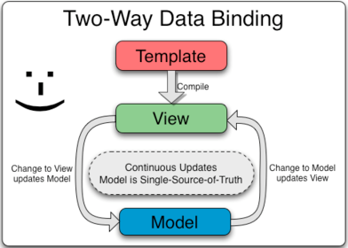
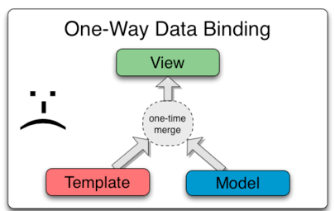
Data Binding – What’ta view!

Slide 7
Controllers
Use them to:
Set up the initial state of the $scope object.
Add behavior to the $scope object.
Do not use them to:
Manipulate DOM — Controllers should contain only business logic.
Format input
Filter output
Share code or state across controllers

Slide 8
Services
https://blog.thoughtram.io/angular/2015/07/07/service-vs-factory-once-and-for-all.html
Used for exchanging data between controllers
Lazily instantiated
Singletons

Slide 9
Scope
Let’s look at the code

Slide 10
Dependency Injection
Load the code as and when it is required
Similar to including libraries in C,C++
Two different annotations: inline array and function

Slide 11
Templates
HTML markup and more …
Use the following to construct:
Directive
Markup
Filter
Form controls

Slide 12
Expressions & interpolation
Undefined and null are converted to ''
If the value is an object that is not a Number, Date or Array, $interpolate looks for a toString() function on the object, and uses that.
If the above doesn't apply, JSON.stringify is used
ng-attr

Slide 13
Filters
https://docs.angularjs.org/guide/filter

Slide 14
Forms
https://docs.angularjs.org/guide/forms

Slide 15
Directives
Ways to declare directives
Isolated scope vs parent scope
Used to create custom events/elements

Slide 16
Modules
Config block:
Provider recipe
Constants recipe

Slide 17
ECMA6 – The new kid on the block
http://es6-features.org

Slide 18
Angular Material – The design language
https://material.angularjs.org/latest/

Slide 19
Setting up a project
You need:
Gulp
Babel
Browserify
Or
https://julienrenaux.fr/2015/05/05/creating-an-application-with-angularjs-1-4-ecmascript-6-material-design-and-webpack/

Slide 20
Two way data binding
Let’s do the form again!

